Slide 1
SENTIMENT ANALYSIS
Srishti Chaubey

Slide 2
Outline
Why Sentiment Analysis
Classification of Sentiment Analysis
Methods Involved
Past Work
Languages Preferred
Challenges

Slide 3
Revolutionary Changes
Content Consumers
Content Sharers
Before Web 2.0
Few content creators
Many Content Consumers
Slow Connections
The value was based on only consuming the content.
After the evolution of Web 2.0
Content Facilitators
Fast Connections
The value is now based on user created data.
More Users, More Content

Slide 4
Sentiment v/s Opinion
Opinion – There could be opinion without sentiments
Sun rises in the east.
(We can’t predict whether it’s good or bad).
Sentiments – They always have an emotion attached with them
I am feeling blessed.

Slide 5
Sentiment Analysis
Sentiment analysis, also called opinion mining, is the field of study that analyzes people’s opinions, sentiments, evaluations, appraisals, attitudes, and emotions towards entities such as products, services, organizations, individuals, issues, events, topics, and their attributes.
Bing Liu. Sentiment Analysis and Opinion Mining, Morgan & Claypool Publishers, May 2012.

Slide 6
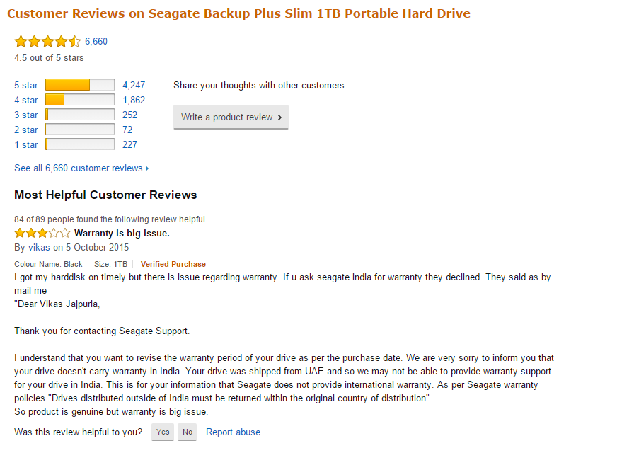

Slide 7
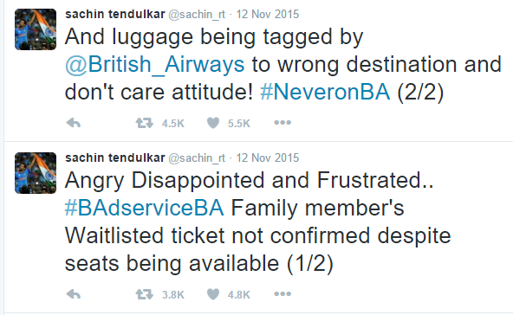
Tweet depicting Sentiment

Slide 8
SA – A Highly Challenging Problem
Before 2000 there was little research in this area
It is a problem which involves the study of Data mining, Information Retrieval and NLP
Computer Science to Management Sciences

Slide 9
Different Levels of Sentiment Analysis
Document Level
Sentence Level
Aspect Level

Slide 10
Document Level
Sentiment of the whole document is classified based on the overall sentiment.
It assumes that there is
a single object
a single opinion holder

Slide 11
Sentence Level
We need to classify text according to the following at sentence level:
Subjective: e.g., It is such a nice phone.
Objective: e.g., I bought an iPhone a few days ago.

Slide 12
Aspect Level
Both Document Level and Sentence Level could not provide enough information about what people like/dislike.
It judges sentiment based on various features in the document.
It is also called as the study of all the available quintuples.

Slide 13
Aspect Level
Entity Extraction and Categorization
Aspect Extraction and Categorization
Opinion Holder Extraction and Categorization
Time Extraction and Standardization
Aspect Sentiment Classification
Quintuple Generation

Slide 14
Methods Involved
Supervised Learning Approach
Semi-Supervised Learning Approach
Unsupervised Learning Approach

Slide 15
Naïve Bayes Algorithm
It is a simple classification method based on Bayes rule.
It works on a simple representation
Bag of words
γ ( doc ) = C
Here the document could be a product review/ movie review

Slide 16

WORDS | COUNT
Loved | 2
Great | 1
Laughed | 2
… | …
Bag
Of
Words
Classifier
Positive Class
Negative Class

Slide 17
Baye’s Rule
For a given document d and a given class c, we have:
P(d|c) P(c)
P(c|d) = ----------------
P(d)
P(c|d) – Probability of a class given a particular document
P(d|c) – Probability of a document given a particular class

Slide 18
Naïve Bayes Classifier
C_{map}
Argmax P(c|d)
=
c ε C
Argmax P(d|c) P(c)
=
c ε C
P(d)
=
Argmax P(d|c) P(c)
c ε C
where ;
P(d|c) - Likelihood
P(c) – Prior Probability

Slide 19
Multinomial Bayes Assumption
P( x₁,x₂, x₃, …x_{n}|c)
Bayes Assumption – Assume that the position of the features doesn’t matter.
Conditional Assumption – Assume that the above defined probabilities are independent of the given class c.
P( x₁,x₂, x₃, …x_{n}|c) = P(x₁|c)· P(x₂|c) ·P(x₃|c) · … · P(x_{n}|c)

Slide 20
The Learning Approach for MNB
Extract the Vocabulary, from the training set
For each c_{j} in C do
doc_{j} all docs with class = c_{j}
P(c_{j}) |docs_{j}| / |total no. of documents|
Calculate P (w_{k} | c_{j}) terms
Text_{j} a single document that contains all docs_{j}
For each word w_{k} in vocabulary
n_{k} no. of occurences of w_{k} in text_{j}
P(w_{k} | c_{j}) (n_{k} + 1) / (n + V)

Slide 21
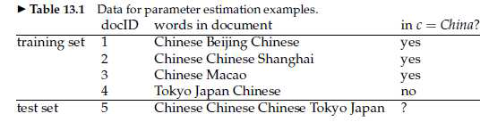
Naïve Bayes Example
Source: Manning et al, 2008
P̂( c ) = N_{c}/N
P̂(w|c)= (count (w,c)+1)/ (count(c) + |V|)
Continued…

Slide 22
Priors:
P(c) = 3/4 and P(j) = 1/4
Conditional Probabilities :
P(Chinese | c) = (5+1)/ (8+6) = 3/7
P(Tokyo | c) = (0+1)/ (8+6) =1/14
P(Japan | c) = (0+1)/(8+6) =1/14
P(Chinese | j) = (1+1)/ (3+6) = 2/9
P(Tokyo | j) = (1+1)/(3+6) =2/9
P(Japan | j) = (1+1) / (3+ 6) =2/9
Choosing a Class:
P(c|d) = 3/4 * (3/7) * 1/14 * 1/14 ≈ 0.00003
P(j|d) =1/4 * (2/9) * 2/9* 2/9 ≈ 0.00001

Slide 23
Semi-Supervised Learning Approach
These are called Sentiment Lexicon based Approach
Makes use of dictionary available as a public domain.
Examples of positive sentiment words are beautiful, wonderful, and amazing.
Examples of negative sentiment words are bad, awful, and poor.
Bing Liu’s page on opinion mining :
https://www.cs.uic.edu/~liub/FBS/opinion-lexicon-English.rar

Slide 24
Hatzivassiloglou and Mckeown 1997
Few labeled set of data (seed words)
Expand seed set to conjoined adjectives
Classifier assigns the polarity
Clustering the similar group of words/phrases
Outputs the Polarity Lexicon

Slide 25
peaceful
unimpressive
magical
Not fair
great
ugly
welcoming
Positive
Negative

Slide 26
Unsupervised Learning Approach
Uses a Tagger to extract opinion in the form of either adjectives or adverbs or a combination of both; most commonly POS tagger.
Each extracted phrase needs to be assigned some semantic orientation.
Finally on the basis of some aggregated scheme, the ‘positive’ and ‘negative’ classes are defined
Doesn’t require any training data

Slide 27
Turney Algorithm
(Turney ,2002)
Extract a phrasal lexicon from reviews
Obtain their individual polarity
Average all the rating and then decide on the polarity

Slide 28
Extracting and Identifying the tag
 | First word | Second word | Third word
1. | JJ | NN or NNS | Anything
2. | RB, RBR or RBS | JJ | Not NN nor NNS
3. | JJ | JJ | Not NN nor NNS
4. | NN or NNS | JJ | Not NN nor NNS
5. | RB,RBR, or RBS | VB, VBD, VBN, or VBG | anything

Slide 29
Assumption for testing polarity
Positive text co-occurs more with “excellent”
Negative text co-occurs more with “poor”
Measure of co-occurence
Point wise Mutual Information- how much two word co-occur than they were independent
P(word1, word2)
PMI = log2
-----------------------------
P(word1). P(word2)
Continued….

Slide 30
Estimate P(word1) to be HITS (word1)
Estimate P(word1, word 2) to be HITS(word1 NEAR word2)
Polarity = PMI(phrase, “excellent”) – PMI (phrase, “poor”)
HITS(phrase NEAR excellent) HITS(“poor”)
=--------------------------------------------------------
HITS(phrase NEAR poor) HITS(“excellent”)

Slide 31
Language Preferred
Why R?
To collect data from Twitter on a particular event
Supports Statistical analysis
It is widely used among statisticians and data miners for
developing statistical software and data analysis.

Slide 32
Twitter API
Search API : Identifies Twitter applications and users using OAuth. Therefore by providing the link of our twitter application (https://apps.twitter.com/) and certain important authentication keys, we are able to fetch data through twitter.
It focuses on relevance and not completeness.
Streaming API : Same is done by the Streaming API, with a bit difference that it streams data (tweets) on a daily basis.
It focuses on Completeness

Slide 33
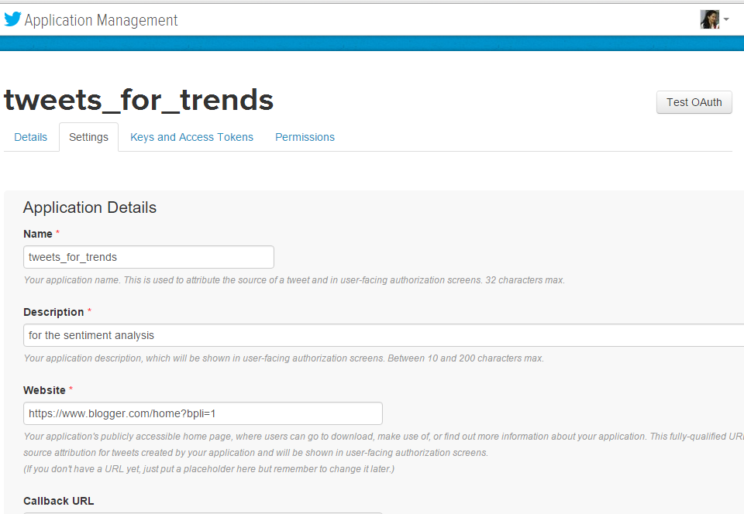

Slide 34
Preprocessing the Tweets
The process of Cleaning Data is as follows:
Removal of the # Tags
Removal of Quotes “”
Removal of @ or USERNAME
Removal of RT
Removal of URL
We will proceed to test tweets for its polarity using the Machine Learning and Semi Supervised Learning Approach

Slide 35
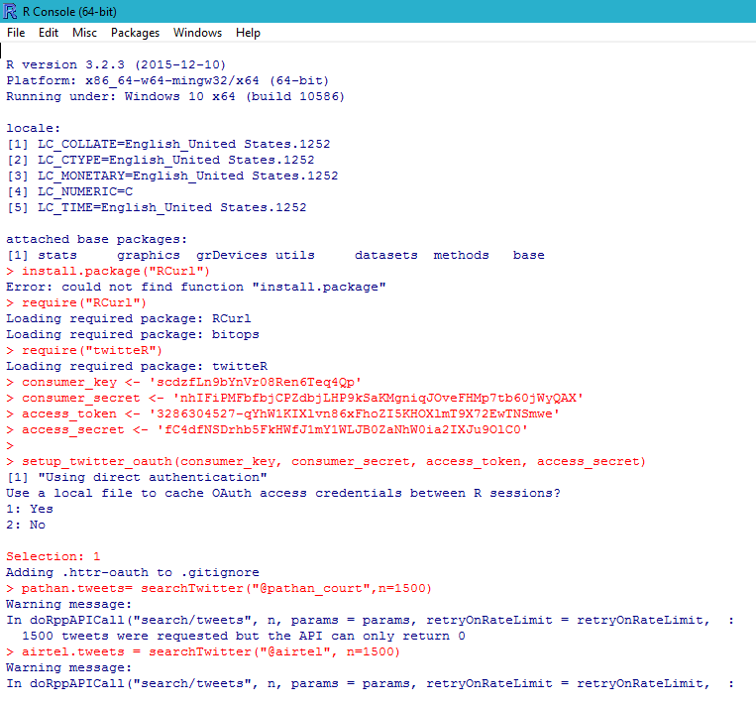

Slide 36
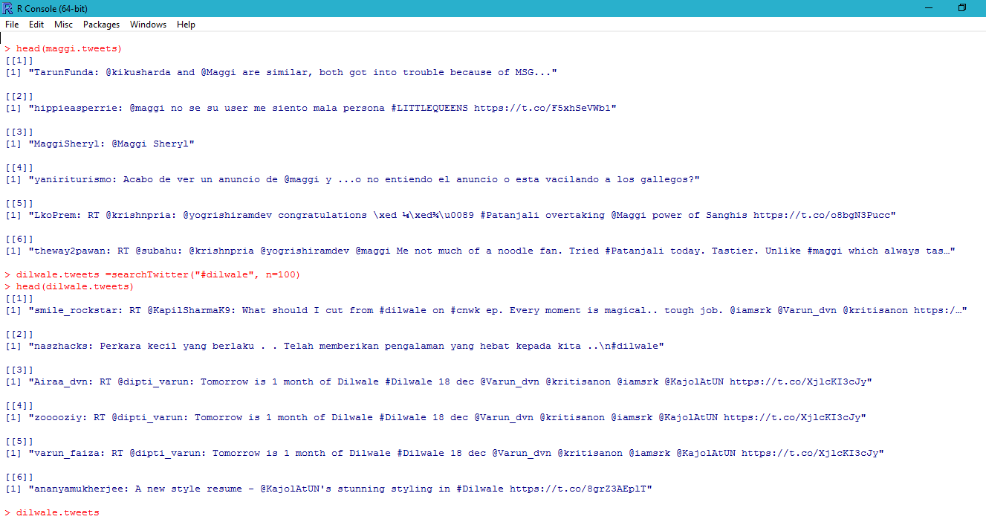

Slide 37
Challenges
Tweets are restricted to 180 characters
Dealing with slangs, symbols, misspelled words
The lack of annotated data sets
Sarcasm handling
Fake or Spam Opinions/Reviews

Slide 38
References
1. E.-P., Chen, H., Chen, G. 2012. “Business intelligence and analytics: Research directions”. ACM Trans.Manage. Inf. Syst. 3, 4, Article 17 (January 2013).
2. Jinjian Zhai, Nicholas Cohen, Anand Atreya, 2011. CS224N Final Project: “Sentiment analysis of news articles for financial signal prediction”.
3. Erik Cambria, Björn Schuller, Yunqing Xia, Catherine Havasi, “New avenues in opinion mining and sentiment analysis”, 2013; sentic.net
4. G. Gebremeskel ,“A Sentiment Analysis of Twitter Posts about News”, M.tech Thesis, University of Malta, 2011.

Slide 39
5. D.M. Sharma, M.M. Baig “Sentiment Analysis on Social Networking: A Literature Review”; IJRITCC, http://www.ijritcc.org, 2015
6. V.K. Singh, R Piryani, P Walia “Computing Sentiment Polarity of Texts at Document and Aspect Levels”; ECTI Transactions On Computer And Information Technology Vol.8, No.1 May 2014.
7. Bing Liu., “Sentiment Analysis and Opinion Mining”, Morgan & Claypool Publishers, May 2012.

Slide 40
THANK YOU

